Slide 1
Project 1 : Insurance Premium Prediction
Mentor : sriraman sir
Presented by : Kushal Singh Ramgadiya

Slide 2
Index
Project Introduction/ Problem Statement
Describe the dataset
Describe the analysis on the data
Model and Summary
Feature selection techniques
Different Algorithms & comparison chart
Conclusion

Slide 3
Project Introduction
Insurance premium is an amount of money a person / business pays for an insurance policy that covers health, vehicle, home, life insurances etc. The insurer provides coverage for claims made against the policy. Premiums are paid either quarterly, half-yearly or yearly depending upon the terms and conditions.
There are various factors on which the premium amount is dependent on. The premium amount might change depending upon these factors

Slide 4
PROBLEM STATEMENT
Predict the premium charges rate
Important features selection

Slide 5
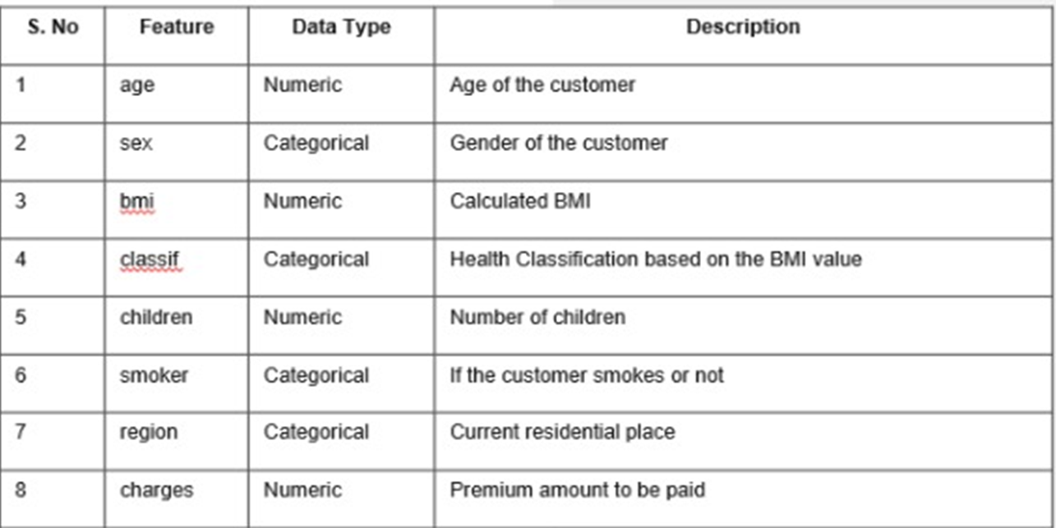
Describe the dataset
The dataset have 1338 rows and 8 columns.
The data contains numerical and categorical data type.
Data also contains features like age, sex, bmi, class if, children, smoker, region and charges.

Slide 6
Steps
Step 1: Importing the libraries
Step 2: Import the dataset
Step 3: Taking care of the missing data
Step 4: Removing duplicates
Step 5: Checking statistical information
Step 6: Separating categorical and numerical columns
Step 7: Outlier Treatment
Step 8: Exploratory data Analysis( Univariate, Bivariate, Multivariate Analysis)
Step 9: Encoding categorical data
Step 10: Feature scaling
Step 11:Splitting the dataset into the training and test sets
Step 12: Building Models
This are the steps on which data has been analyzed.

Slide 7
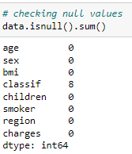
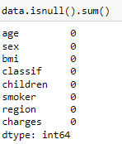
Missing Value Treatment
Before treatment
After treatment

Slide 8
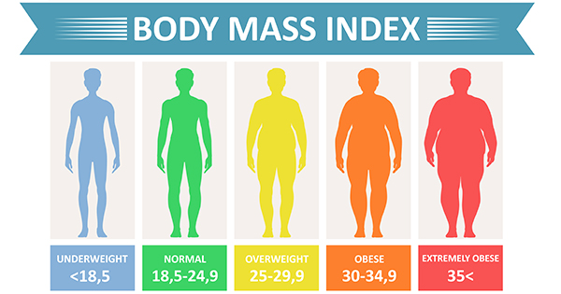
BMI Nutritional status
Below 18.5 Underweight
18.5–24.9 Normal weight
25.0–29.9 Pre-obesity
30.0–34.9 Obesity class I
35.0–39.9 Obesity class II
Above 40 Obesity class III

Slide 9
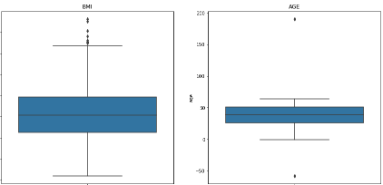
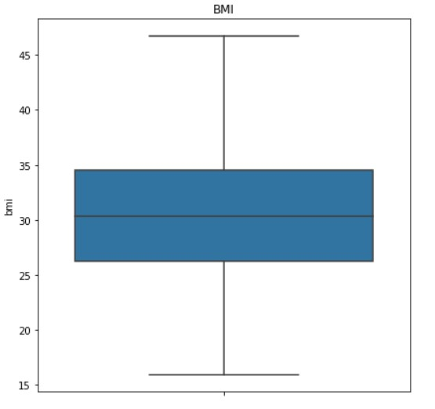
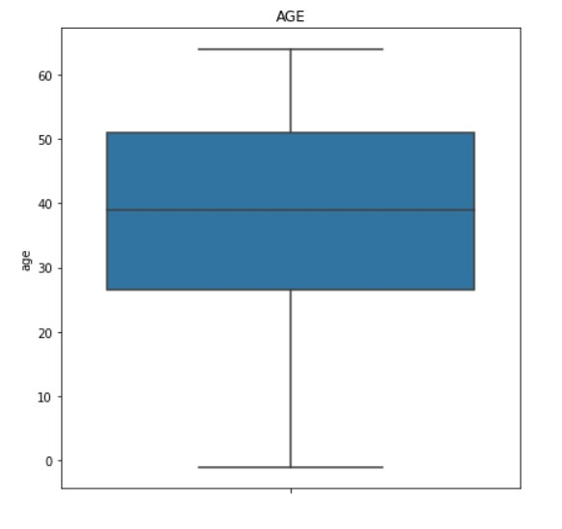
Outlier Treatment
Before treatment
After treatment

Slide 10
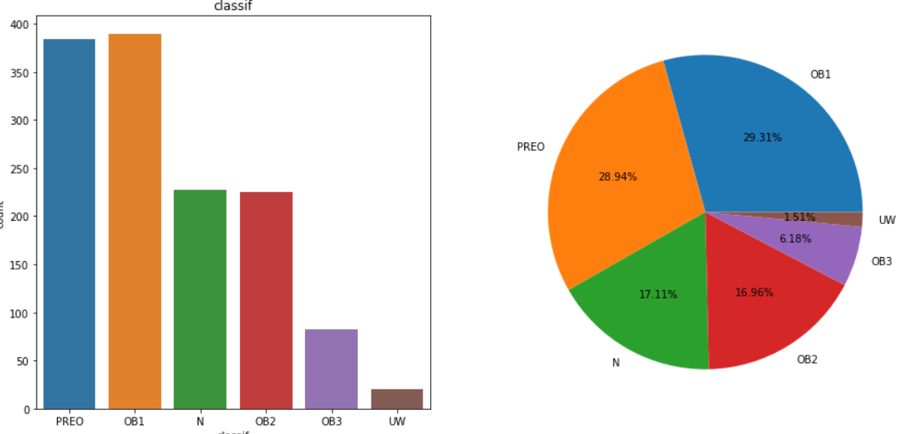
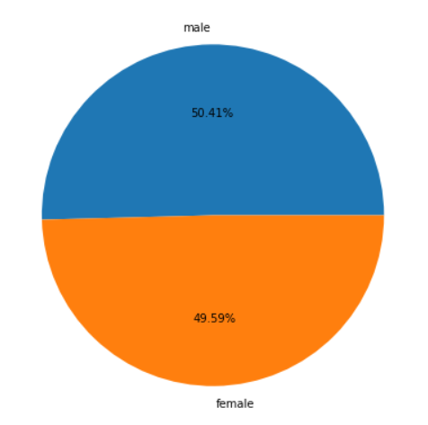
Exploratory Data Analysis ( Univariate)

Slide 11
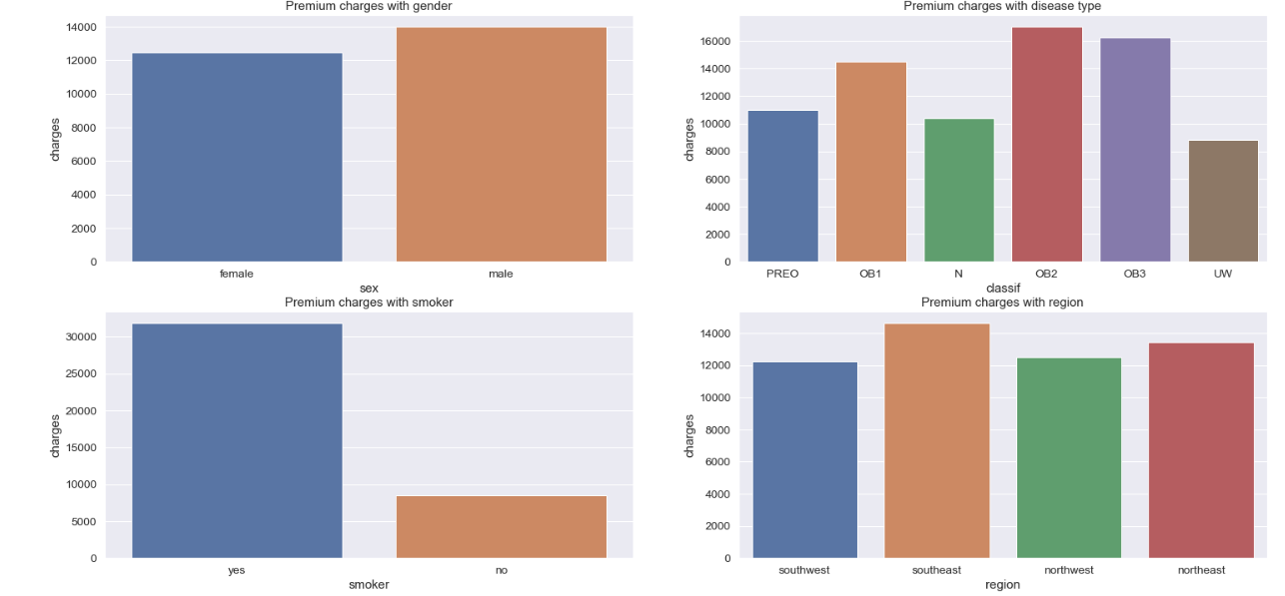
Bivariate

Slide 12
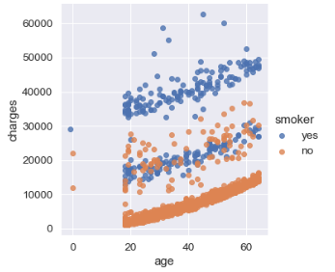
Multivariate
Increasing age is directly impacting the premium charges.
Smoker's are paying higher premium compare to non smokers.

Slide 13
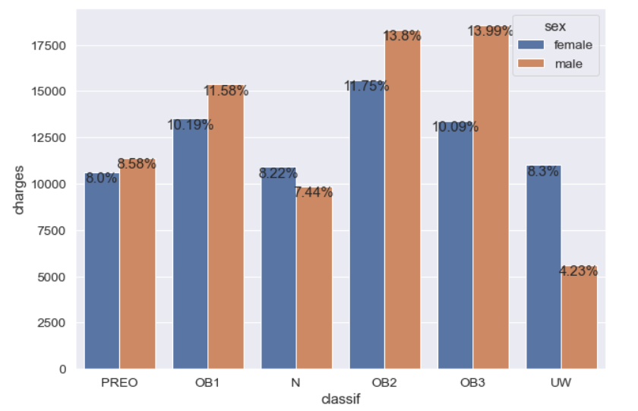
OB2 and OB3 are having higher premium rates as compare to other types.

Slide 14
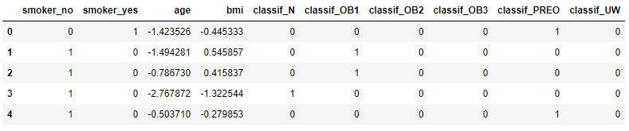
Feature Selection Techniques
Feature selection is the process of reducing the number of input variables when developing a predictive model.

Slide 15
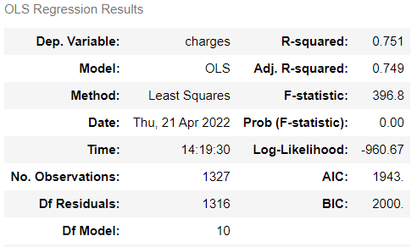
Summary Of Regression Model

Slide 16
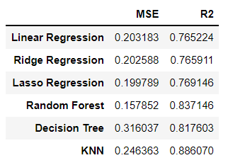
Different Algorithms & Comparison

Slide 17
Final Conclusion
From the above table we can conclude that, The best model to predict Insurance Premium is Random Forest because it has less value of MSE(Mean Square Error) and R square is giving 83 % prediction, which is good model.

Slide 18
Thank You

